Slide 1

GDPredict: A Machine Learning Approach Towards GDP per Capita Prediction
Sanket Kashyap, 23BBS0023
Ujjwal Hirwani, 23BBS0036

Slide 2
Objectives
GDP per Capita Prediction
Modeling key Economic Indicators
Enhancing Policies and Decision Making

Slide 3
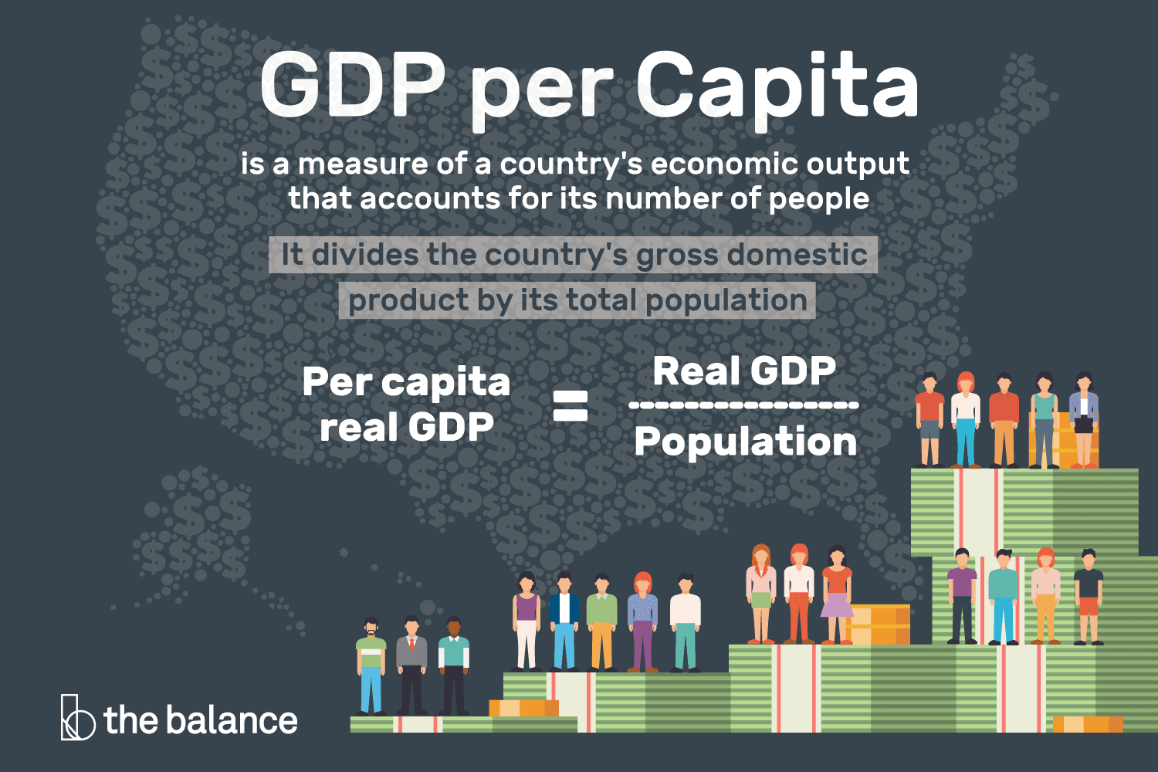
What is gdp per capita?
Living Standards – Indicates the average economic well-being of a population.
Economic Comparison – Allows fair comparison of prosperity across countries.
Policy Planning – Guides government in making development and welfare policies.
Investment Decisions – Helps investors assess market potential and stability.
Growth Tracking – Monitors economic progress over time, adjusted for population.

Slide 4
Literature Review - I
Title: Forecasting Quarterly GDP Growth Rates Using Machine Learning Methods
Author(s): Kristian Jonsson
Journal: National Institute of Economic Research
Link: https://www.konj.se/media/hk3hzmp1/working-paper-157-forecasting-quarterly-gdp-growth-rates.pdf
Methodology Used: The paper's methodology compared three types of linear indicator models (single-indicator, an average of all single-indicator, and a multiple linear model) as baselines against a variety of machine learning algorithms, including Regularized Linear Models, K Nearest Neighbor, Support Vector Regression, Regression Trees, Random Forest, Gradient-Boosted Regression Trees, and Multi-Layer Perceptron, to forecast Swedish quarterly GDP growth
Dateset Used: Economic Tendency Survey (ETS)

Slide 5
Literature Review - I
Summary: The paper "Forecasting Quarterly GDP Growth Rates Using Machine Learning Methods" explores the use of ML models to forecast Swedish quarterly GDP growth, comparing them with traditional linear indicator models. Data is sourced from the Economic Tendency Survey (ETS) of the National Institute of Economic Research (NIER). Baseline models include single-indicator, averaged single-indicator, and multiple linear models estimated via OLS. ML techniques investigated are Regularized Linear Models (Lasso, Ridge, Elastic Net), K Nearest Neighbor, Support Vector Regression, Regression Trees, Random Forest, Gradient-Boosted Regression Trees, and Multi-Layer Perceptron. These methods aim to enhance forecasting accuracy over traditional approaches.
Key Findings and Results: Machine learning models, especially Gradient-Boosted Regression Trees, Random Forest, and Multi-Layer Perceptron, outperformed traditional linear models across all forecast accuracy metrics.

Slide 6
Literature Review - II
Title: Machine Learning in GDP Nowcasting: From Lagging Indicators to Leading Algorithms
Author(s): Ilya Kislitskiy, Serhii Marinchenko, Vitalii Veremiienko
Journal: Social Science Research Network (SSRN)
Link: https://papers.ssrn.com/sol3/Delivery.cfm/5251604.pdf?abstractid=5251604&mirid=1
Methodology Used: The reviewed research compared machine learning models (Random Forest, Gradient-Boosted Regression Trees, SVR, and Multi-Layer Perceptron, among others) and traditional models (Dynamic Factor Models and simple autoregressive models) for their ability to nowcast GDP using large datasets of high-frequency indicators, consistently finding that ML models offer a significant improvement in accuracy.
Dateset Used: Central Bank of Jordan from Q1 2008 to Q3 2023

Slide 7
Literature Review - II
Summary: These papers generally find that machine learning (ML) models are effective tools for "nowcasting" or providing real-time estimates of economic indicators like GDP, which are often released with a significant delay. A nowcast is a prediction for the present, the very recent past, and the very near future. The research demonstrates that ML models can handle large, complex datasets of high-frequency indicators to improve the accuracy of GDP nowcasts compared to traditional econometric models.
Key Findings and Results: Machine learning models, particularly tree-based and neural networks, significantly improve nowcasting accuracy reducing forecast errors by 16–28% over traditional benchmarks—when evaluated using metrics like MFE, MAE, MSE, and RMSE.

Slide 8
Literature Review - III
Title: A Machine Learning Approach to Nowcasting GDP with Limited Data Span: The Case of Jordan
Author(s): Amany Al-Rawashdeh
Journal: CBJ Working Paper
Link: https://cbj.gov.jo/EBV4.0/Root_Storage/AR/Research_and_working_papers/%D8%A8%D8%AD%D8%AB-A_Machine_Learning_Approach_to_Nowcasting_GDP_with_Limited_Data_.pdf
Methodology Used: The study used an Extreme Gradient Boosting (XGBoost) nowcasting approach for Real Gross Domestic Product (RGDP) in Jordan. This methodology used quarterly and monthly high-frequency data from the Central Bank of Jordan and classified it by economic sector. The results were compared to benchmark models, including Long Short-Term Memory (LSTM), Autoregressive Moving Average (ARIMA), and Dynamic Factor Models (DFM). The Mean Squared Error (MSE) was used as the primary evaluation metric to assess the performance of each model.
Dateset Used: Central Bank of Jordan from Q1 2008 to Q3 2023

Slide 9
Literature Review - III
Summary: The paper introduces an XGBoost model for nowcasting GDP in Jordan and compares its accuracy to traditional models like LSTM, ARIMA, and DFM. The study found that XGBoost provided highly accurate projections, with a very low Mean Squared Error (MSE).
Key Findings and Results: The XGBoost model accurately nowcasted Jordan's Q4 2023 GDP growth at 2.4%, which was very close to the actual 2.3%. It had the lowest Mean Squared Error (MSE) of 0.000833, significantly outperforming benchmark models.

Slide 10
Our Interpretation
Prioritize Machine Learning (ML): ML models consistently outperform traditional methods for GDP nowcasting.
Use Diverse Data: Incorporate a wide range of high-frequency economic indicators for better accuracy.
Focus on Top-Performing Models: Implement and fine-tune models like XGBoost, Random Forest, and Neural Networks.
Validate with Standard Metrics: Use Mean Squared Error (MSE) and other standard metrics to evaluate model performance.
Address Data Asynchrony: Develop a robust strategy to handle the "ragged edge" challenge of data availability.

Slide 11
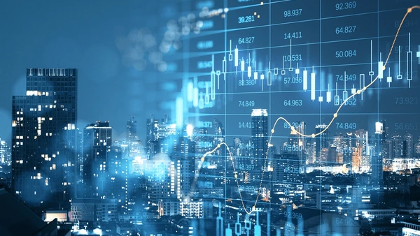
Proposed Methodology
Economic Indicator Identification
Data Sourcing
Data Cleaning & Feature Scaling
Exploratory Data Analysis
Regression Model Implementation
Model Accuracy Assessment
Result Interpretation

Slide 12
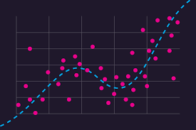
What is Regression?
Definition: Regression is a supervised learning technique used to predict a continuous numeric value by modeling relationships between a dependent variable and one or more independent variables.
Purpose in Project: To estimate GDP per capita using economic indicators like inflation rate, unemployment rate, trade balance, and education index.
Why Use Regression?
Captures trends in historical data.
Quantifies impact of each economic factor.
Enables accurate economic forecasting.
Common Models: Linear Regression, Random Forest Regressor, XGBoost Regressor, Support Vector Regression.
Output: A predicted GDP per capita value for given input indicators.

Slide 13

Thank You

